Slide 1
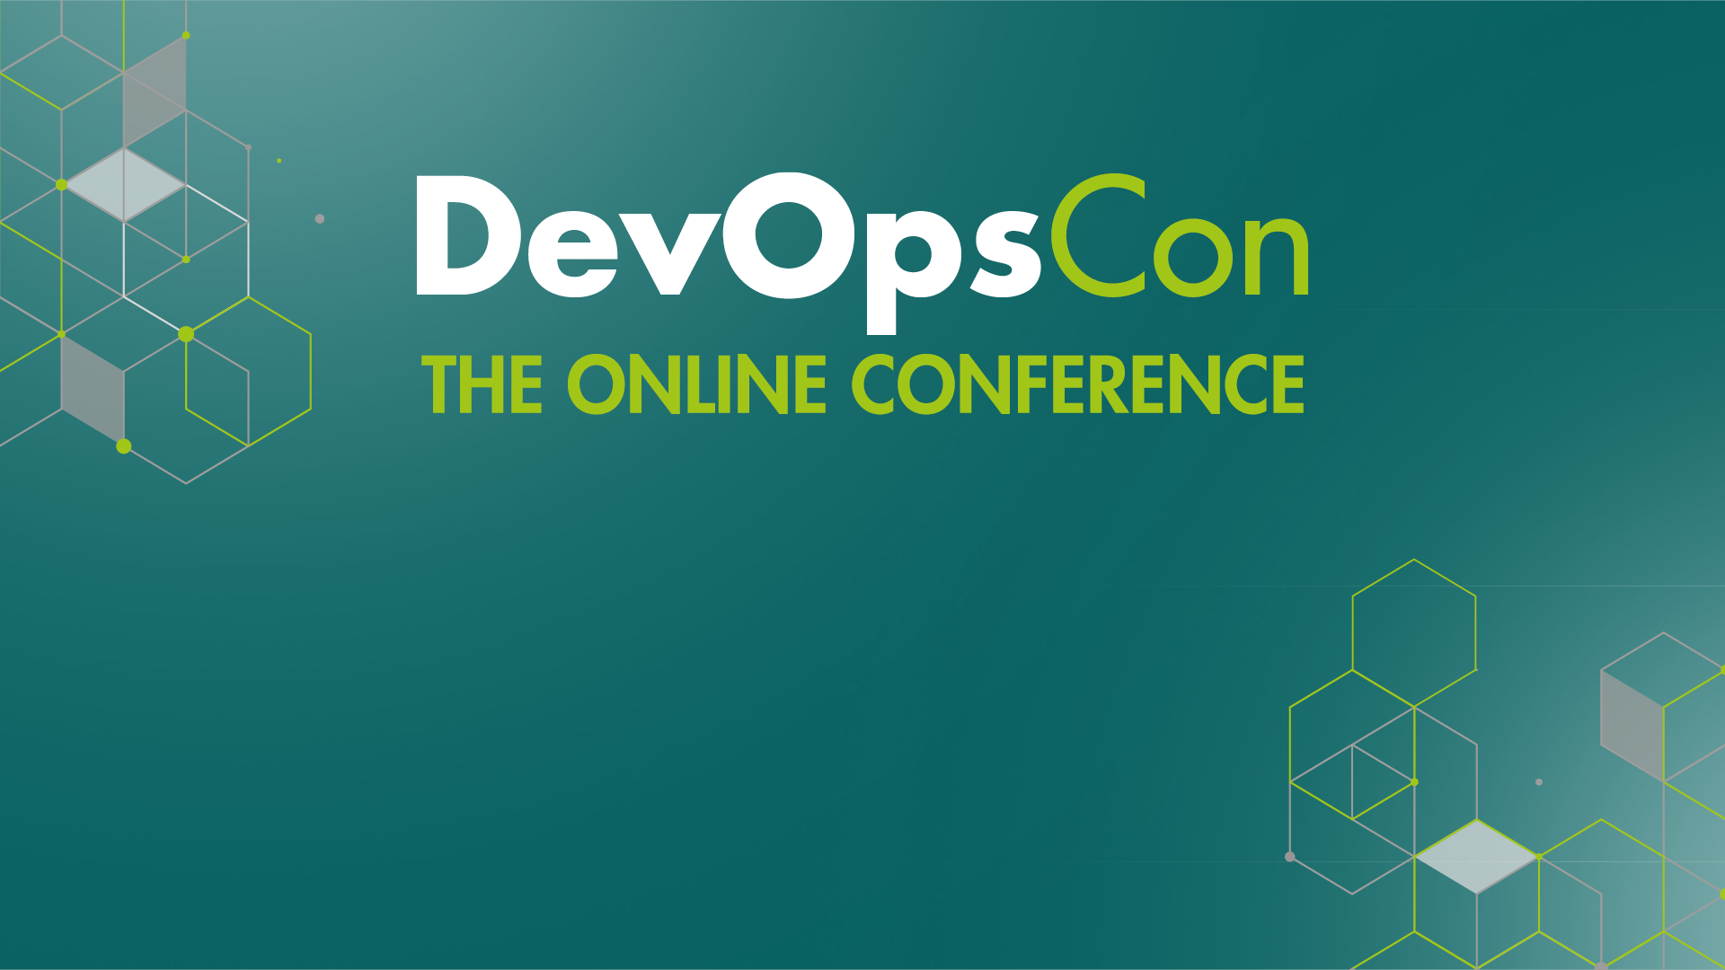
Deploy long-running workloads on Azure
Roberto Freato – CTO @Witailer
Notes:
Budget – 1min

Slide 2
what we want to deploy
Triggered Jobs
by a schedule
Continuous Jobs
always on
by a third party
on demand
singleton?
scalable?
Notes:
Budget – 55min
Cleanup tasks
Check tasks should run only in certain times
Something can be triggered by the end of another process (pipeline)
Q: Can we have multiple concurrent executions?
Q: Do you know Zapier?
Q: Do you know Logic Apps? Or Flow?
Triggered vs While(true) with Sleep
Always on for Queue logic
Scaling is encouraged
On demand vs Triggered
Continuous jobs should not fail

Slide 3
from IaaS to Serverless
Location
Hardware
Networking
OS
Configuration
Runtimes
Application
Location
Hardware
Networking
OS
Configuration
Runtimes
Application
IaaS
PaaS
Application
Serverless
Notes:
Budget – 2min
Differences between the models
Serverless is essentially PaaS, with less details
In PaaS, runtime can eventually be plugged in
PaaS is the most efficient way to scale
But IaaS is always better than self-host, why?
Serverless can help to avoid boilerplate
Serverless often has lock-in, PaaS sometimes
IaaS has not lock-in itself, but the underlying OS
Some market considerations around IaaS/PaaS/Serverless
Examples: GAE, Lambda, Functions

Slide 4
compute quadrant (opinionated)
Notes:
Budget – 5min
How to read this quadrant and how’s made
Information is accurate but personal
Scale may depends on soft or hard limits of the platform
Examples of soft and hard limits
Ease of management can be the degree of interest we need to have to the underlying infrastructure
Or either the lock-in aspect
Or the industry-standard adherence

Slide 5
azure batch
Notes:
Budget – 5min
Essentially the PaaS on Scale Sets
Adds the proper software to orchestrate VMs/sets and assign jobs
Provides an API to create new tasks
Let users decide pools in type and size

Slide 6
demo
azure batch

Slide 7
app service
Notes:
Budget – 5min
Born as Windows Azure Web Sites
Support for both Web and Worker workloads
Different runtimes
Support for Windows and Linux workloads (webjobs exception)
Support for Containers
Limited scalability
No lock-in
What is billed?

Slide 8
demo
app service

Slide 9
containers instances
Notes:
Budget – 5min
Think about many, big AKS clusters
Spawn new containers in seconds with a target CPU and memory
Deploy containers serverless
Can be used with AKS to provide additional and dynamic capacity to the fixed node pools

Slide 10
demo
container instances

Slide 11
takeaways
Identify Platform-as-a-Service as a overhead-killer option
Choose the service based on the management/scaling perspective
Embrace containers in any case (which are present and future)
Go with Batch when you need a machine type
Go with App Service when you need simplicity
Go with Container Instances when you need temporary workloads

Slide 12
question time

Slide 13
Deploy long-running workloads on Azure
Roberto Freato – CTO @Witailer
Notes:
Budget – 1min

